Slide 1
Presentation 24
SQA project process standards
IEEE software engineering standards
The structure and content of IEEE software engineering standards
IEEE/EIA Std. 12207 – Software life cycle processes
IEEE Std. 1012 - verification and validation
IEEE Std. 1028 - reviews

Slide 2
Classes of IEEE standards
A. Conceptual standards. Guiding principles and overall approach
* IEEE 1061 – Software Quality Metrics Methodology
* IEEE/EIA 12207.0 — Information Technology Software
Life Cycle Processes
B. Prescriptive standards of conformance. Requirements to which a software developer must conform. •
* IEEE 829 — Software Test Documentation
* IEEE 1012 – Software Verification And Validation
* IEEE 1028 – Software Reviews
C. Guidance standards. Implementation of class B standards.
* IEEE 1233 – Guide for Developing System Requirement
Specifications
* IEEE/EIA 12207.1 – Guide, Information technology – Software Life
Cycle Processes – Life Cycle Data
• •

Slide 3
The purpose of
IEEE/EIA Std 12207
<> To establish an internationally recognized model of common software life cycle processes that can be referenced by the software industry worldwide.
<> To promote understanding among business parties by application of commonly recognized processes, activities and tasks.

Slide 4
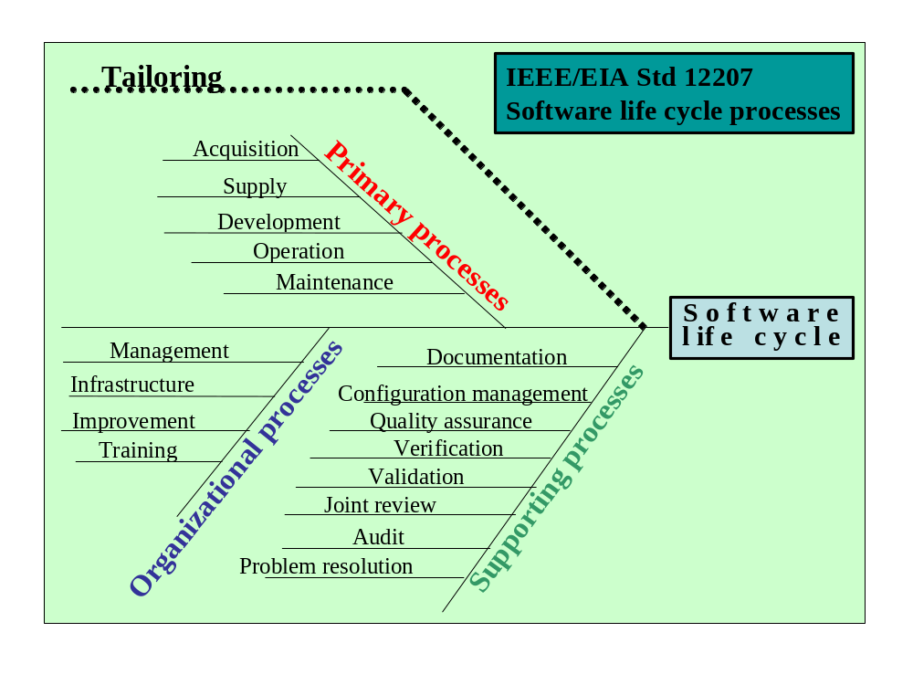
Source: IEEE (1992). From IEEE Std 10 45-19992. Copyright 1992 IEEE. All rights reserved.

Slide 5
IEEE/EIA Std 12207.0 concepts
General concepts
Applicability of the standard in general and its adaptation by tailoring
Applicability for all participants in the software life cycle
Flexibility and responsiveness to technological change
Software links to the system
TQM consistency
No certification requirements
Baselining
Task-related concepts
Responsibility for activities and tasks
Modularity of components of software life cycle
Levels of required conformance
Nature of evaluation task

Slide 6
The purpose of IEEE Std 1012
* Establish a common framework for V&V activities and tasks for all software life cycle processes.
* Define V&V requirements, including their inputs and outputs.
* Define software integrity levels and the appropriate V&V tasks.
* Define the content of a SVVP (software V&V Plan) document.

Slide 7
IEEE Std 1012 concepts
Broad definition of V&V activities
Software integrity levels and their V&V requirements
Prescriptive requirements
* Detailed description of the performance methodology.
* Required inputs.
* Required outputs.
* Definition of integrity levels for which performance of the task
is not mandatory.
* Optional V&V tasks to be performed during selected life cycle
process.
Independence of V&V activities
Compliance and compatibility with international standards
Special characteristics of reusable software V&V
Application of V&V metrics
Quantitative criteria for V&V tasks

Slide 8
The processes
covered by IEEE Std 1012
(1) Management
  (2) Acquisition
  (3) Supply
  (4) Development
  (5) Operation
  (6) Maintenance
  A three level tree architecture:
  - Processes (each includes 1-6 activities)
  - Activities (each includes 3-10 tasks)
  - Tasks

Slide 9
Types of reviews
covered by IEEE Std. 1028
Management reviews
Technical reviews (in the book “formal design reviews”)
Inspections
Walkthroughs
Audits

Slide 10
The purpose of IEEE Std 1028
To define systematic review procedures
that are:
* Applicable for reviews performed
throughout the software life cycle
* Conform with the review equirements
defined by other standards

Slide 11
IEEE Std 1028 concepts
  High formality
  Follow-up of corrections
  Compliance with international and IEEE standards

Slide 12
Review requirements
of IEEE Std.1028
Document structure:
(1) Introduction
(2) Responsibilities The responsibilities of the participants in the review.
(3) Input Mandatory and optional data items.
(4) Entry criteria Common criteria: a. a statement of the review's objectives. b. Availability of the required input data.
(5) Procedure Required to include: management preparations, planning, team preparation, examination of the products, follow up of corrections.
(6) Exit criteria What must be accomplished before the review can be concluded.
(7) Output items
(8) Data collection recommendations To be used to study the effectiveness and efficiency of current practices.
(9) Improvements Formulate improved procedures, checklists and development processes.

